Slide 1


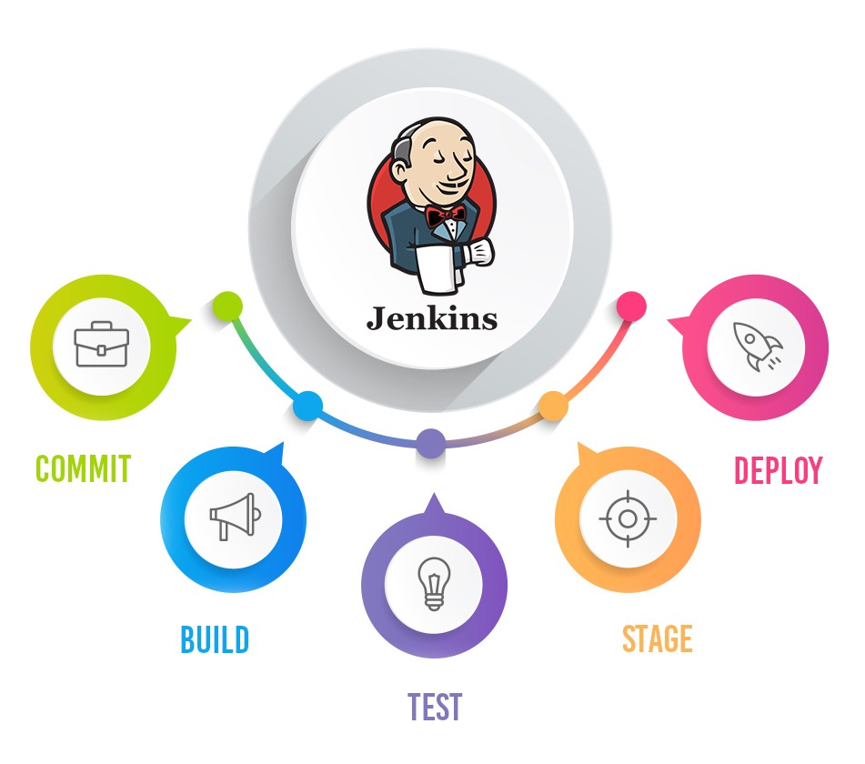
Jenkins Mastery for Software Tester
Pramod Dutta
Workspace Clean in Jenkins

Slide 2

What we need to Delete Workspace?
Low Space
Delete old builds

